Slide 1
Reinforcement Learning-Driven Patch Attention
for Urban Scene Segmentation
SETTY BHAVANA
[IITMCS_240681]

Slide 2
Introduction
Traditional segmentation → treats every pixel equally
Real-world driving → focus on critical regions (road, car, pedestrian)
Proposed: RL-driven patch attention + UNet for better segmentation

Slide 3
Problem Statement
Design RL-based attention mechanism for patch-wise focus
Actor-Critic agent assigns attention weights
UNet performs segmentation on attention-weighted image
Goal: maximize mIoU (esp. road, car, pedestrian)

Slide 4
Objectives
Build patch-level Actor-Critic attention policy
Integrate RL-attention with UNet
Improve accuracy on crucial classes
Visualize attention maps & interpret behavior
Benchmark vs vanilla UNet/self-attention

Slide 5
Background & Resources
Dataset: Cityscapes Mini (128×128 images)
Concepts: Actor-Critic RL, Spatial Attention, UNet
Libraries: PyTorch/TensorFlow, OpenCV, Matplotlib, Seaborn

Slide 6
Methodology (Step 1-2)
Preprocessing: Resize to 128×128, Normalize, Divide into NxN patches
Feature Extraction: CNN to extract patch features

Slide 7
Methodology (Step 3-5)
Actor-Critic RL Setup:
- Actor → outputs patch attention weights
- Critic → evaluates reward (mIoU)
- Action → assign patch-wise attention
Segmentation Pipeline: Apply attention → UNet → compare GT
Training Loop: RL + UNet joint optimization

Slide 8
Evaluation Metrics
Mean IoU (road, car, pedestrian focus)
Attention Map Visualization (heatmaps)
Reward Trend (episode convergence)
Overlay Outputs (input, prediction, GT)

Slide 9
Deliverables
Jupyter Notebook: training + evaluation
Demo Video: live patch attention visualization
Final Report: methods, results, plots
Graphs: IoU vs episodes, reward curves
Visuals: attention maps & segmentation overlays

Slide 10
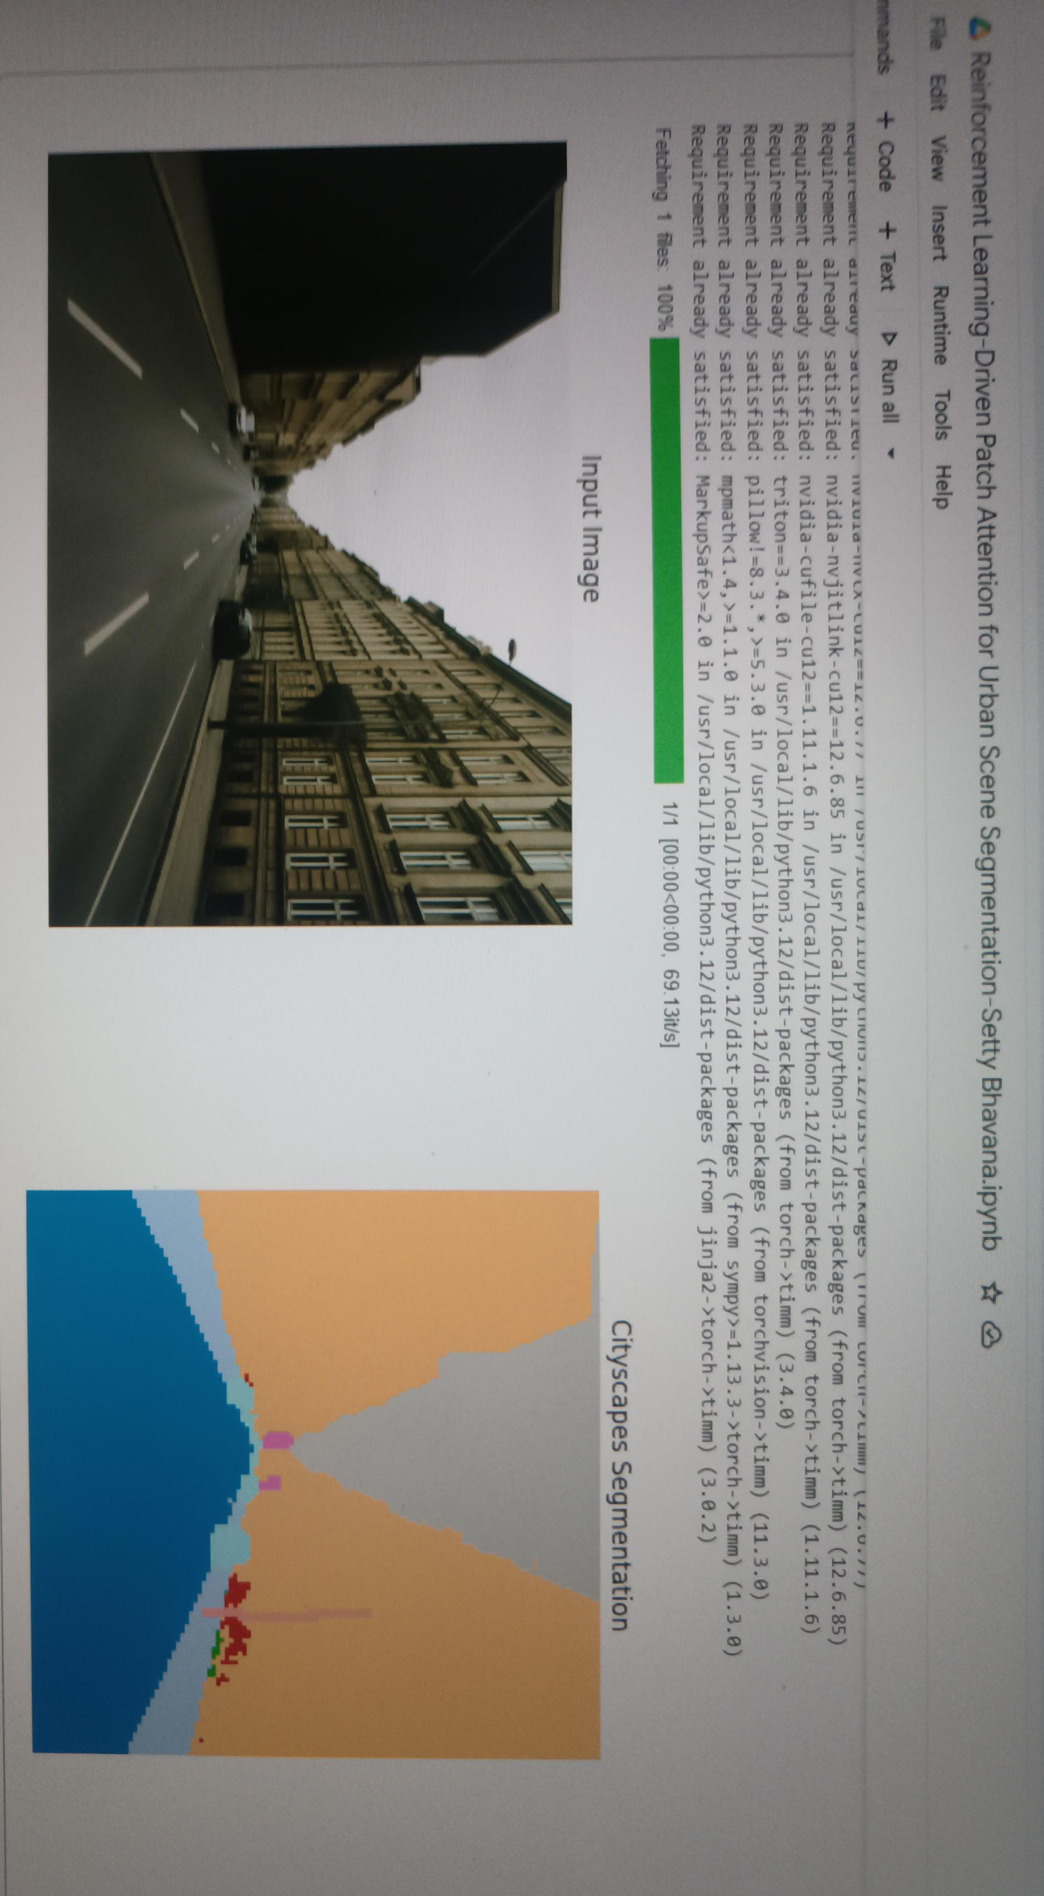

Slide 11
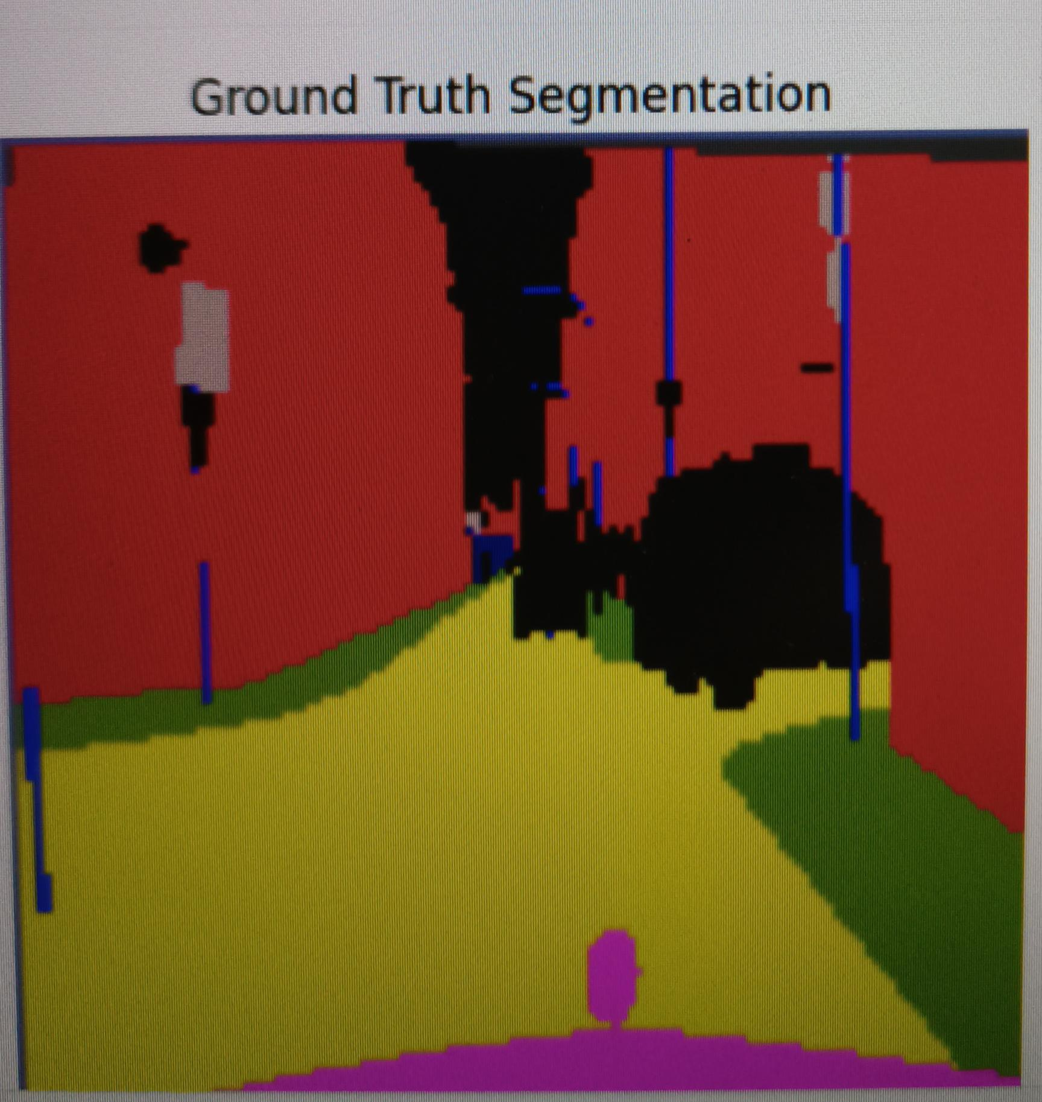

Slide 12
Week-Wise Plan
Week 1: Data prep + patching
Week 2: Actor-Critic setup + UNet pipeline
Week 3: Joint training & evaluation
Week 4: Visualization, report, PPT, video demo

Slide 13
Conclusion
RL-driven patch attention improves segmentation on key classes
Actor-Critic learns to highlight informative regions
Outperforms vanilla UNet on urban scene segmentation
Future work: extend to larger datasets, multi-scale patches

